Slide 1
Migrating SSIS Packages from 2005 to 2008 Lessons Learned
David Cobb
MCT, MCITP SQL DBA,Dev,BI
MCSE,MCAD
david@davidcobb.net

Slide 2
How do I migrate SSIS Packages from 2005 to 2008
Just ask MSDN
http://msdn.microsoft.com/en-us/library/cc280546.aspx
Open SSIS project in VS 2008
Run Wizard
Backup Original Packages
Done!
Wasn’t that easy?

Slide 3
Thanks For Listening!
Questions?

Slide 4
Just Kidding! Migrating SSIS Packages can be a significant project…
Because of dependencies:
Databases for SQL Connections must be migrated, along with users, permissions, configurations.
Paths for File Connections must be reproduced, with correct permissions.
Executables in Process Tasks must be migrated.
Interactions with other servers (File shares, web services, etc.) need correct permissions.
Because of storage issues
Packages in MSDB,File System or SSIS Package Store?
ProtectionLevel of packages, what happens to passwords in my packages when I migrate?

Slide 5
My Scenario
Client has SQL 2005 32 bit production server to migrate to SQL 2008 R2 64 bit. Need to migrate SSIS packages.
Over 70 SSIS packages called by 12 SQL Agent jobs, many failing without clear cause.
Inconsistent visibility on package execution (Send mail task, custom logging, logging provider, SQL Agent Job History)
Many, many undocumented SSIS Packages unreferenced by SQL jobs as well.

Slide 6
Issues
Existing packages running in SQL 2005, stored in MSDB. No source code.
Original developer unavailable.
Inconsistent logging, error handling. Client has log text files, log tables, SQL Agent job history, and Send Mail tasks to sift through to troubleshoot a problem.
Packages with ProtectionLevel EncryptSensitiveWithUserKey the default, prevents execution, migration.
Dave to the rescue!

Slide 7
Get at the packages’ code stored in MSDB
To get at the code in the packages, need to export them from MSDB to folder structure.
Found a great tool for this job: http://www.windowsitpro.com/article/tips/easily-import-and-export-ssis-packages.aspx (Could have used DTUTIL one package at a time)
In VS 2005, create new SSIS project in each folder and add existing packages.
OK I can see code! Let’s migrate to SQL ‘08

Slide 8
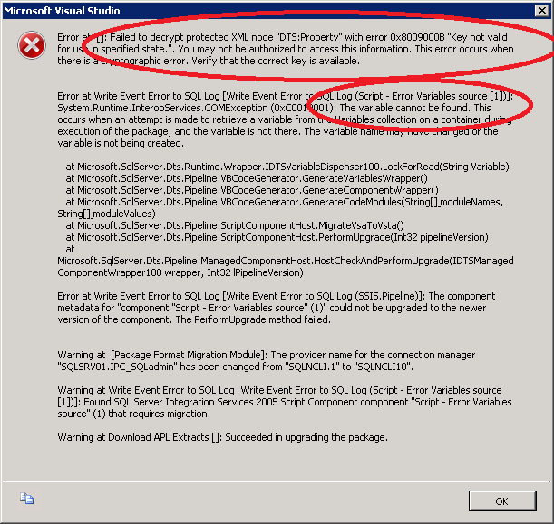
SSIS Migration Wizard
Open project in VS 2008, Run upgrade wizard, and get this error:
Similar errors in SQL Agent log: Failed to decrypt protected XML node “DTS:Password”
Why?

Slide 9
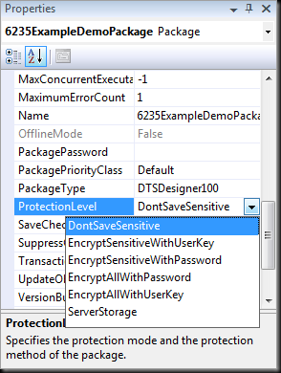
ProtectionLevel
Packages are code plus secrets to protect
Sql user passwords
Ftp passwords
Other connection strings
EncryptSensitiveWithUserKey is default, but can’t share packages with other developers or execute from service account. The developer who creates package is the ONLY ONE who can access this variable!
In a production environment the right answer (IMHO) is DontSaveSensitive plus Package Configurations!

Slide 10
How do I fix it?
Change protection level on ALL the packages to DontSaveSensitive.
Locate and change any property marked as Sensitive=1 and set to =0.
May have an Encrypted=1 property as well
BEFORE: <DTS:Property DTS:Name="ServerPassword" Sensitive="1" Encrypted="1">AQAAA…Jq+rcOiv</DTS:Property>
AFTER: <DTS:Property DTS:Name="ServerPassword"></DTS:Property>
Need to provide this property to the package another way than storing in the dtsx… enter Package Configurations!

Slide 11
Package Configurations
Set values of package variables or properties using:
XML config file (good if you aren’t nervous about saving passwords in file system in clear text)
Environment variable (useful for non sensitive data)
Registry (ditto, and harder to manage and deploy)
Parent Package (not applicable here)
SQL Server (Easier to protect databases and tables than file system. This was our choice. You can even encrypt the values in SQL, we’ll likely do in phase 2.)

Slide 12
Have to edit 70 SSIS Packages by hand? You can..
Ask to get paid by the hour.
Warm up your mouse finger.
OR
Use a text editor with search and replace in files.
My editor of choice was Notepad++

Slide 13
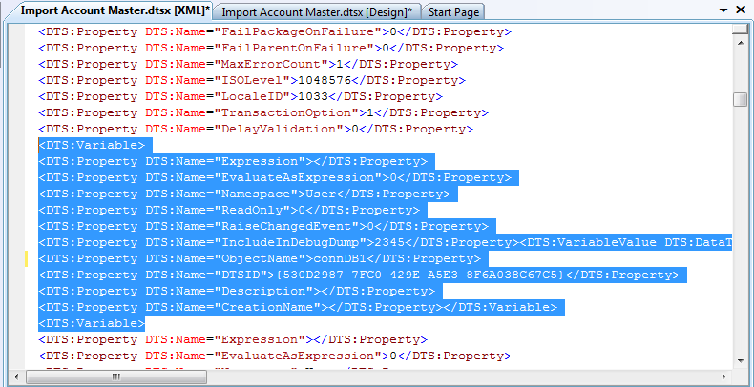
SSIS Packages are a GUI front end on XML code!
Right-click the dtsx in Visual Studio, choose View Code.
Useful for simple changes within identifiable properties. (Replace oldServerName with newServerName, good luck doing that in the GUI.)
Can also add package variables this way, by creating in a template package, copying, and pasting.

Slide 14
More Search and Replace Goodness
Search for ‘:\’ and ‘\\’ to locate all file paths. Ensure these exist in your new environment.
Search for ‘SMTP’ for tasks that send mail.
Search for ‘Executable=‘ for Execute Process tasks. Ensure these are in your new environment.

Slide 15
Template Package
Create a template package that contains all your:
Package variables (Copy and paste in from Code View, then close and reopen dtsx to see them).
Connection Managers (Right-click, copy from template package, then paste into target package).

Slide 16
Logging
Goal: Ensure each run of each package is logged to a unique filename eg. PackageName20110309120000.csv
Each package gets a File Connection ‘connLog’
The file path is defined by an expression:
@[User::connLogFolder] + @[System::PackageName] + (DT_STR,4,1252)DATEPART( "yyyy" , @[System::StartTime] ) + RIGHT("0" + (DT_STR,4,1252)DATEPART( "mm" , @[System::StartTime] ), 2) + RIGHT("0" + (DT_STR,4,1252)DATEPART( "dd" , @[System::StartTime] ), 2) + RIGHT("0" + (DT_STR,4,1252)DATEPART( "hh" , @[System::StartTime] ), 2) + RIGHT("0" + (DT_STR,4,1252)DATEPART( "mi" , @[System::StartTime] ), 2) + RIGHT("0" + (DT_STR,4,1252)DATEPART( "ss" , @[System::StartTime] ), 2) + ".csv“

Slide 17
Results
Every execution of each package logged in one place
Able to troubleshoot, correct, and test each package successfully from VS
Now to deploy to SQL..

Slide 18
Deployment and Automation
Script all the SQL Jobs from SQL Mgmt Studio:
Select Jobs folder under SQL Agent
Open Object Details from View menu
Select jobs you want to script and right-click, Script Job As..
Modify script for new server
More search and replace from old server to new.
I changed the all the package sources from SQL to File, for easier management.
EXEC @ReturnCode = msdb.dbo.sp_add_jobstep @job_id=@jobId, @step_name=N'Check for Holidays',
…
@command=N'/FILE "E:\SSISRoot\packages\Shared\isDayAfterHoliday.dtsx" /CHECKPOINTING OFF /REPORTING E',
…

Slide 19
Where do I put everything related to my SSIS Packages?
I set up an E:\SSISRoot folder
...\Root\CheckpointFiles
...\Root\Configurations
...\Root\ErrorFiles
...\Root\Logs
...\Root\Packages
...\Root\RawFiles
Etc..
Keep all dependencies in once place where possible.

Slide 20
All in the process..
Created a spreadsheet to manage this process

Slide 21
Results part 2..
Tested, corrected and verified newly created SQL Jobs
HAPPY CLIENT!

Slide 22
References
Understanding the 3 options for SSIS Package Storage http://sqlsafety.blogspot.com/2010/10/package-storage-msdb-folder-or-package.html
Issues with executing packages and ProtectionLevel http://support.microsoft.com/kb/918760
ProtectionLevel options and pros and cons of each http://bi-polar23.blogspot.com/2009/04/ssis-and-package-protectionlevel.html
Export and Import SSIS Packages http://www.windowsitpro.com/article/tips/easily-import-and-export-ssis-packages.aspx
Encrypting SSIS Configurations in SQL
http://sqlblog.com/blogs/michael_coles/archive/2010/01/18/ssis-mo-secure-configurations.aspx
SSIS Logging to unique filename http://www.bidn.com/blogs/timmurphy/ssas/1246/append-timestamp-to-log-file-name
SSISRoot folder for deployment
http://consultingblogs.emc.com/jamiethomson/archive/2006/01/05/SSIS_3A00_-Common-folder-structure.aspx
SSIS Best Practices http://consultingblogs.emc.com/jamiethomson/archive/2006/01/05/ssis_3a00_-suggested-best-practices-and-naming-conventions.aspx
Many of the links above are GREAT SSIS blogs, you’ll learn a lot from these guys!

Slide 23
Questions?
David Cobb
david@davidcobb.net

